Slide 1
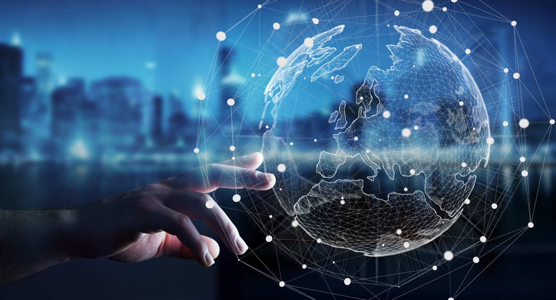
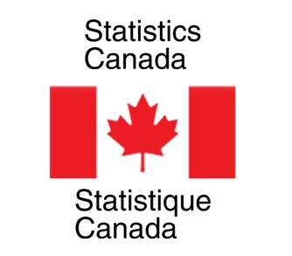


Nowcasting Macroeconomic Indicators
using Google Trends
Presented By:
Aishwarya Sharma
Harpreet Kaur
Jagdeep Brar
Date: 21st June, 2022
IMAGE: https://wallpapersafari.com/w/swTjG4

Slide 2

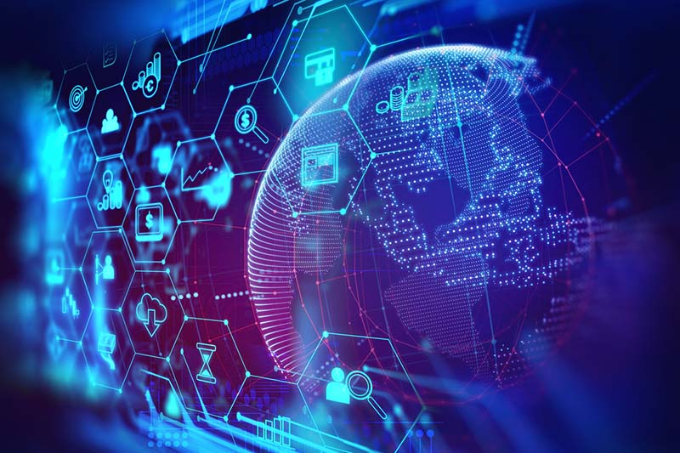






OUTLINE
INTRODUCTION TO TEAM AND CLIENT
OVERVIEW OF PROJECT
DATA SET
METHODOLOGY
ANALYSIS AND INTERPRETATION
CONCLUSIONS
FUTURE DIRECTIONS
Image link: https://cleanfax.com/science-and-technology/trends-restoration-technology/

Slide 3


Introduction
To Team
Image: https://elearning.ihtsdotools.org/mod/book/view.php?id=1772

Slide 4

AISHWARYA SHARMA
Bachelors in Computer Science
Former Software Developer in Hewlett Packard Enterprise (HPE)
Passion for data and listen to music in free time

Slide 5

JAGDEEP BRAR
Ph.D. in Applied Mathematics
Worked on Credit Risk Management Projects as
a Postdoc
Likes painting and cooking!!

Slide 6
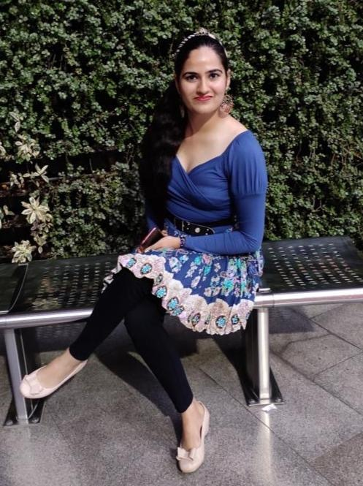
HARPREET KAUR
Gold Medalist in Applied Mathematics
Former Software engineer
Love hiking, making and tinkering

Slide 7
Introduction
To Clients
Statistics
Canada
Image: https://elearning.ihtsdotools.org/mod/book/view.php?id=1772

Slide 8

NICK NEWSTEAD
Economist, Sociologist
Data Exploration and Integration
Strong Data Science Background

Slide 9
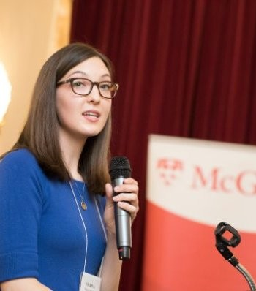
MARINA SMAILES
Senior Analyst
Data Exploration and Integration Lab
Microdata, Demographic Analysis

Slide 10
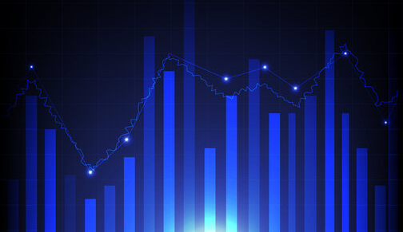
OVERVIEW
Image :https://stock.adobe.com/de/images/illustration-abstraction-of-descriptive-statistics-business-concept-stats-of-stock-market-graph-isolated-on-blue-background/387901017?as_campaign=ftmigration2&as_channel=dpcft&as_campclass=brand&as_source=ft_web&as_camptype=acquisition&as_audience=users&as_content=closure_asset-detail-page

Slide 11
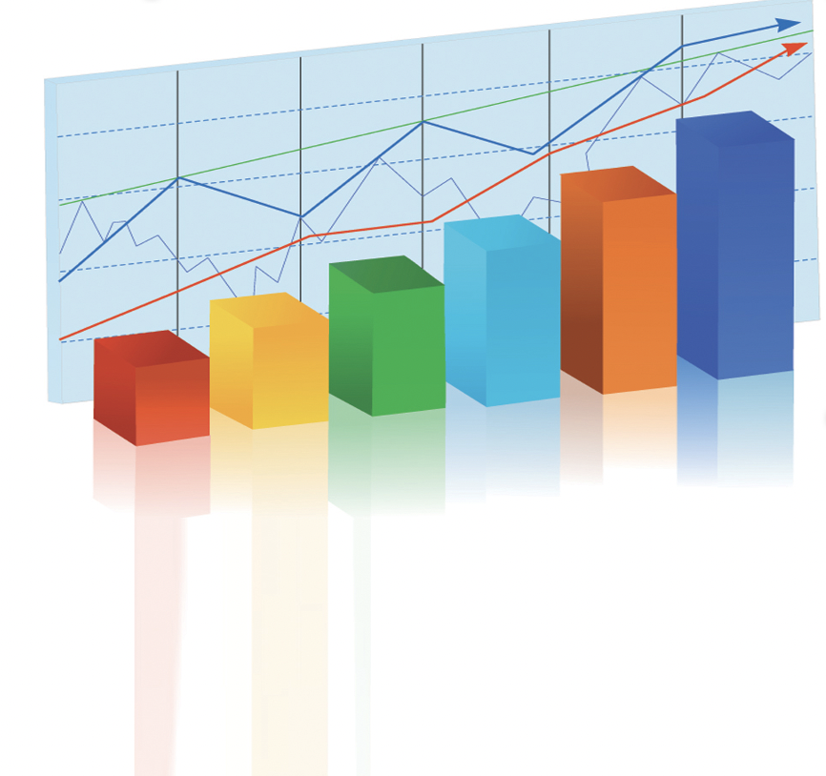

Economic Indicators
Crucial for country’s policy and decision making
Issue
Information contains lag
Develop model to nowcast indicators using Google Trends
Aim
Image : https://www.slidebackground.com/collection/statistics

Slide 12
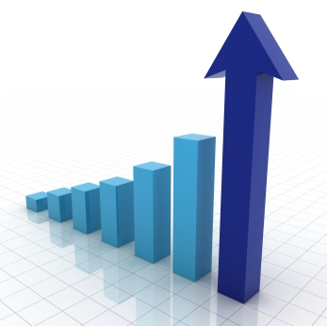
Gross Domestic Product
Retail Trade Sales
E – Commerce Sales
Image : https://www.greenbiz.com/article/scaling-circular-economy-requires-digital-revolution

Slide 13

What is Lag in
Information ?
Image : https://www.pngitem.com/middle/TiRmRm_confused-person-clipart-transparent-background-confused-clipart-black/

Slide 14
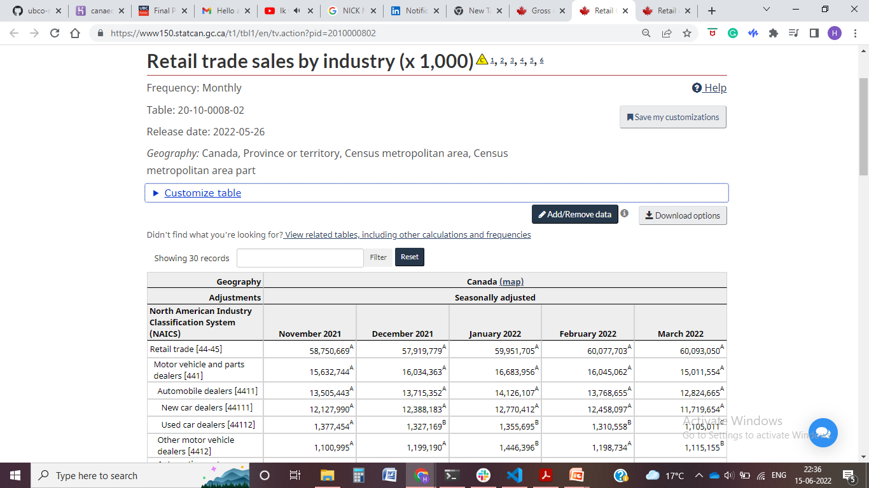
Retail Trade Sales (RTS) monthly (x 1,000)
No values for April and May 2022 – lag of 2 months
Solution: Use alternate data source to estimate current period indicators
Alternate data source: Google Trends
Snapshot: https://www150.statcan.gc.ca/t1/tbl1/en/tv.action?pid=2010000802

Slide 15

What are
Google Trends ?
Image: https://www.thenina.com/what-does-a-value-of-100-mean-in-google-trends/

Slide 16
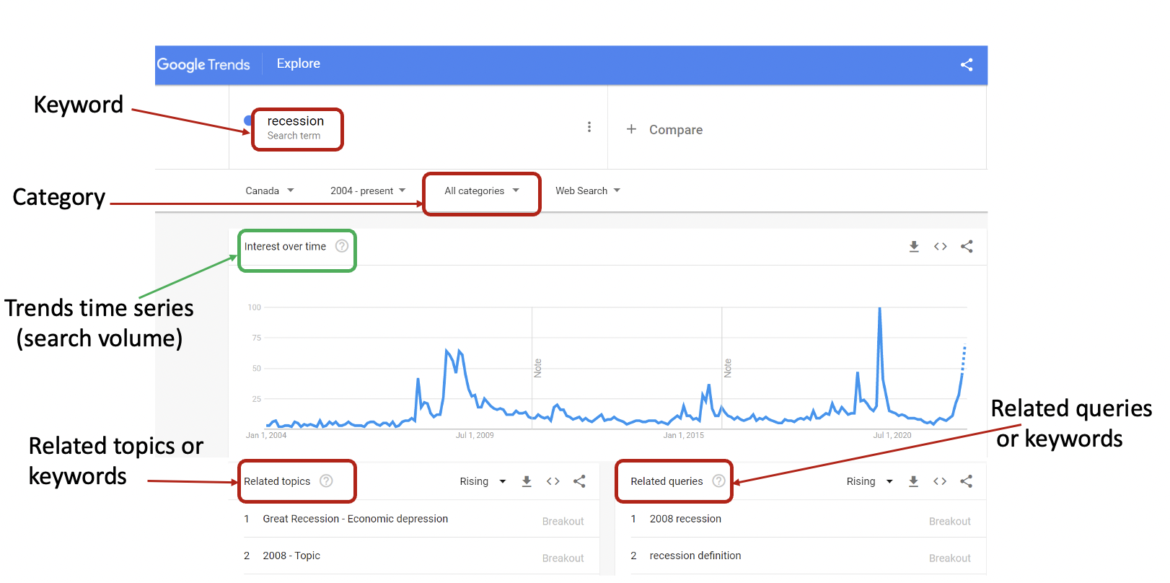
Snapshot: https://trends.google.com/trends/?geo=CA

Slide 17

Why
…?
Image : https://www.searchenginejournal.com/google-trends-seo/226809/

Slide 18
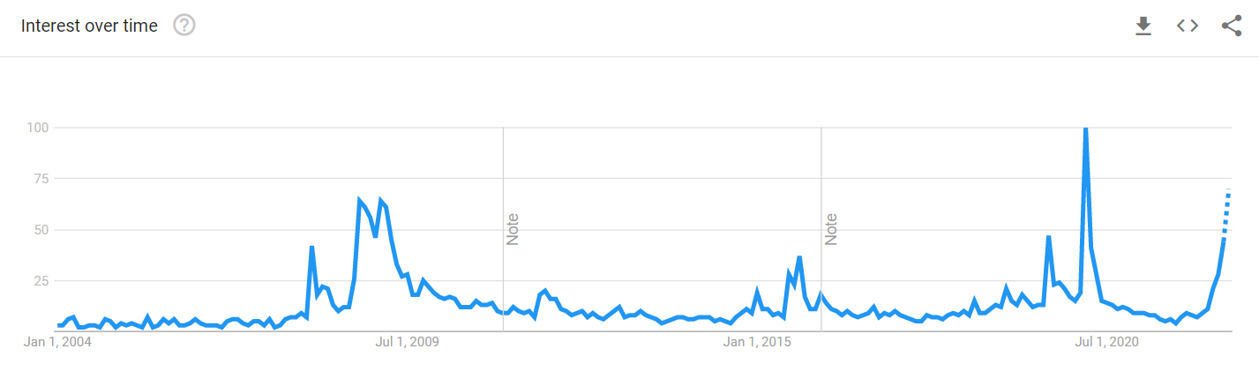
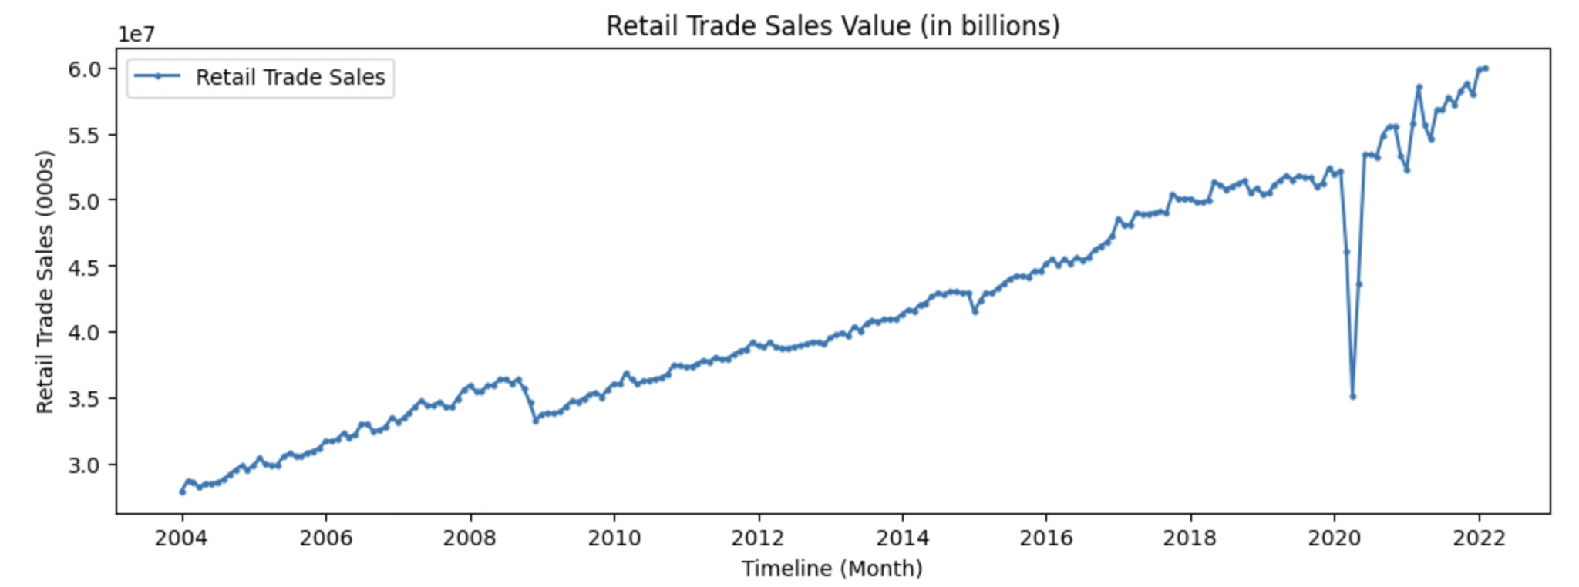
Google Trends of keyword ‘recession’
Available in real time
Search behaviors can
be informative
Macroeconomic indicator – Retail trade sales
Can capture the
economic activity

Slide 19

Why Nowcasting and
not Forecasting
Today’s Google Trends may help to predict today but may not tomorrow
In other words, PREDICTING PRESENT!!
Image : http://clipart-library.com/clip-art/stick-person-transparent-background-23.htm

Slide 20
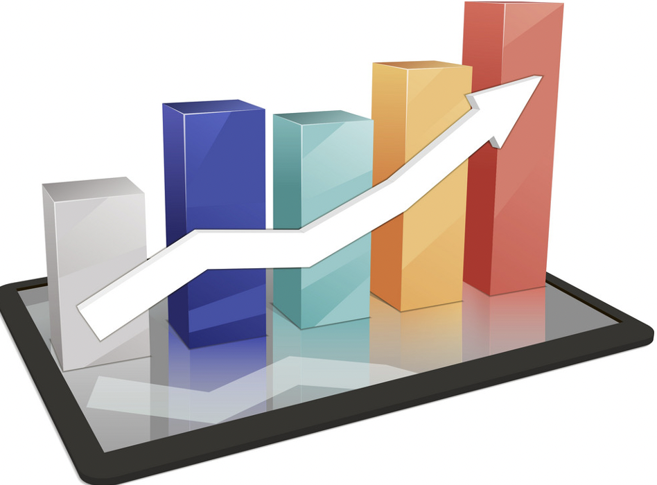
Project Goal:
To Nowcast
GDP
Retail Trade Sales
E – Commerce Sales
Using Google Trends
Image : https://www.vectorstock.com/royalty-free-vector/colorful-3d-background-statistics-template-growth-vector-1974965

Slide 21

Description of Data

Slide 22
csv files
Keywords, categories, queries and topics
Google Trends
using pytrends
Statistics Canada
Response variable
Predictors

Slide 23
Statistics Canada Data
Economic Indicator | Timeline | Frequency
Retail trade sales | 1991-2022 | Monthly
E-commerce sales | 2016-2022 | Monthly
GDP | 1961-2021 | Quarterly
Selected Data for Analysis
Economic Indicator | Timeline | Frequency | Num. of observations | Num. of predictors (trends)
Retail trade sales | 2004-2022 | Monthly | 217 | 396
E-commerce sales | 2016-2022 | Monthly | 74 | 31
GDP | 2004-2022 | Quarterly | 72 | 446

Slide 24

Image : https://www.123rf.com/photo_54129389_methodology-contept-business-man-with-hand-pressing-a-button-on-blurred-abstract-background.html

Slide 25
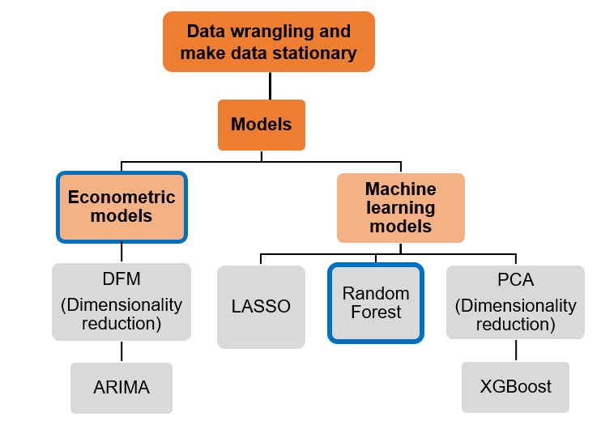
Outperformed for Retail trade sales and
E-commerce sales
Outperformed for GDP
ARIMA - Autoregressive Integrated Moving Average,
DFM - Dynamic Factor Model, LASSO - Least Absolute Shrinkage and Selection Operator, PCA - Principal Component Analysis

Slide 26
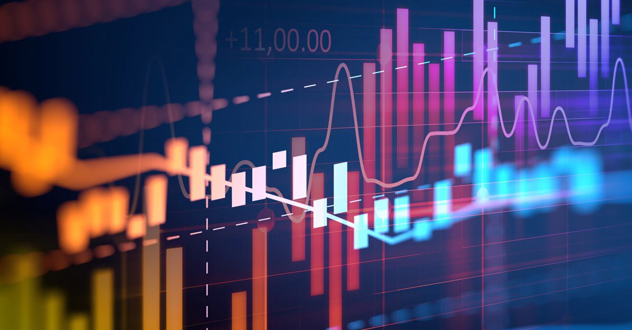
Stationary
Time Series
Removed trend
Removed seasonality
Normalized data
Image : https://www.ppt-backgrounds.net/statistics/2030-statistics-keynote-backgrounds.html
https://yashuseth.wordpress.com/2018/01/19/time-series-analysis-forecasting-modelling-arima/
https://www.congrelate.com/41-big-data-analytics-background-pictures/
https://medium.com/analytics-vidhya/time-series-analysis-84126c2f3097

Slide 27
Select predictors
Apply DFM to predictor space
Econometric
Model- GDP
Cross- validation
Apply ARIMA on selected factors
Block
Bootstrap
One step ahead rolling prediction
with prediction interval

Slide 28
Lagged series of response
Select predictors
Cross- validation
Machine Learning Model- Retail Trade Sales and E – Commerce Sales
Apply Random Forest on
selected predictors
Block
Bootstrap
One step ahead rolling prediction
with prediction interval

Slide 29
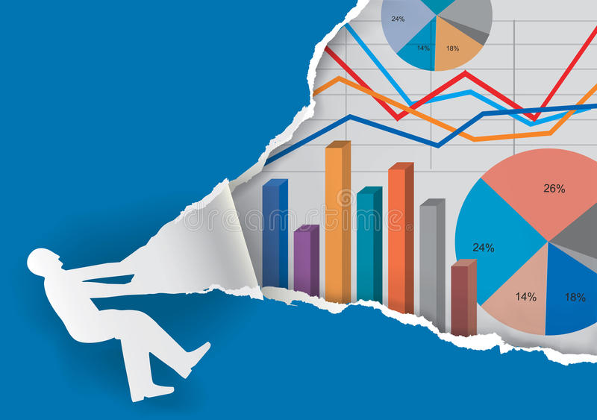
ANALYSIS AND INTERPRETATION
Image : https://www.dreamstime.com/stock-illustration-annual-report-torn-paper-background-man-silhouette-ripping-charts-numbers-presenting-economic-results-vector-available-image83554513

Slide 30
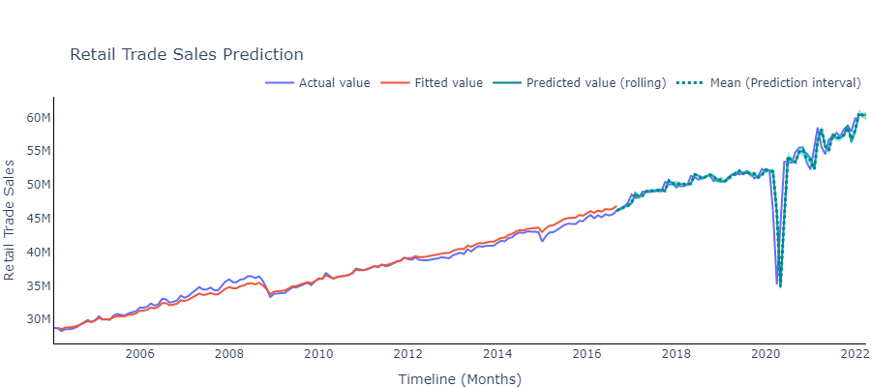
Retail Trade Sales Value Prediction (x 1,000)

Slide 31
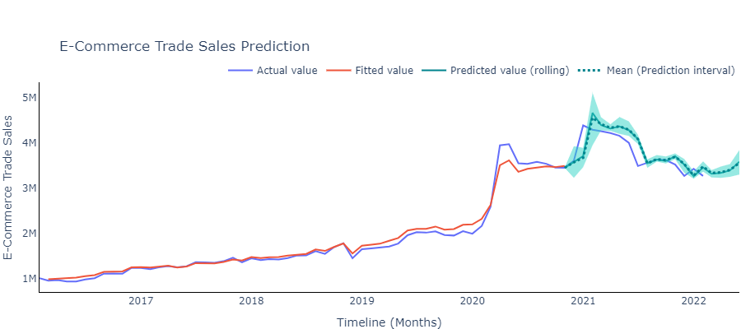
E – Commerce Sales Value Prediction (x 1,000)

Slide 32
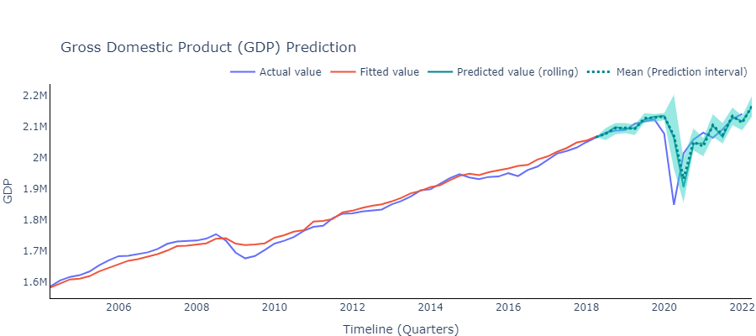
GDP Value Prediction (x 1,000,000)

Slide 33
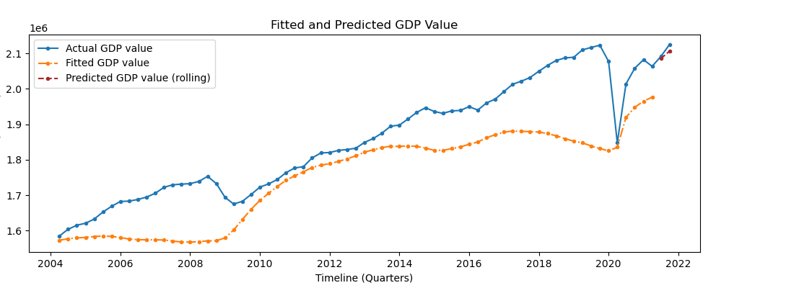
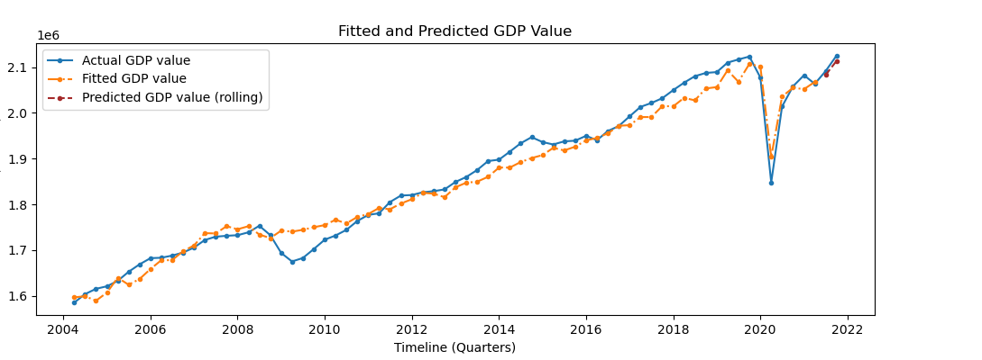
Does Google Trends really help?

Slide 34
Model fit without using Google Trends
Model fit using
Google Trends

Slide 35
INDICATORS | TIMELINE | PREDICTED VALUE | STATISTICS CANADA
Gross Domestic Product (x 1,000,000) | Jan - 2022 | 2,116,718 | 2,140,751
 | April - 2022 | 2,163,537 | -
Retail Trade Sales (x 1,000) | March - 2022 | 60,305,994 | 60,093,050
 | April - 2022 | 60,411,554 | -
E – Commerce Sales (x 1,000) | March - 2022 | 3,315,434 | 3,034,992
 | April - 2022 | 3,333,537 | -

Slide 36
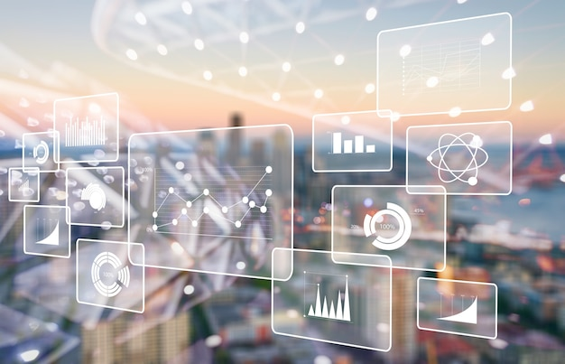
DASHBOARD
https://nowcasting-indicators-canada.herokuapp.com/
Image : https://www.freepik.com/premium-photo/analytics-data-big-business-intelligence-background-bi_18128083.htm

Slide 37
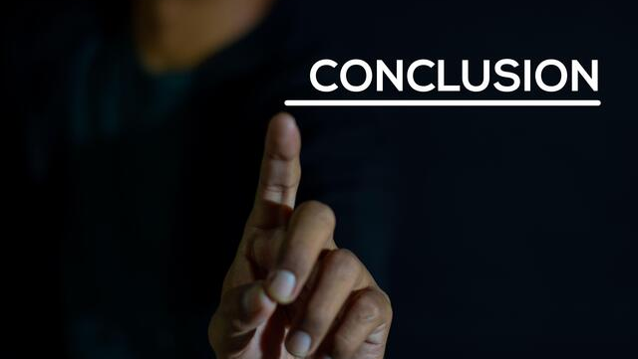
Image : https://www.alamy.com/a-man-write-a-conclusion-with-a-black-background-image346995889.html

Slide 38

Keywords capture behavior of economic activity
Google trends are informative in nowcasting
Nowcasted indicators assist in policy making for government of Canada.
Image : https://stock.adobe.com/ca/search?k=%22statistics+background%22

Slide 39

FUTURE
DIRECTIONS
Image : https://www.istockphoto.com/search/2/image?phrase=future+direction

Slide 40
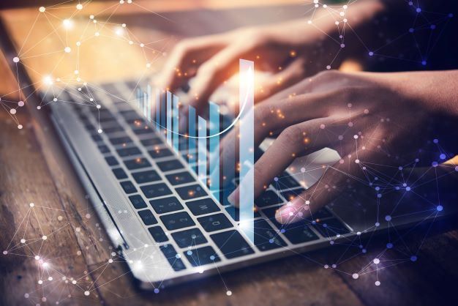
Nowcast the macro-economic indicators at granular level
Research for more keywords or categories to increase accuracy of models
Add more components to the Dashboard
Image : https://ilearn.tuftsctsi.org/catalog?pagename=Scientific-Concepts-and-Research-Design

Slide 41

Nick Newstead
Marina Smailes
Statistics Canada
Prof. Irene Vrbik
Prof. Firas Moosvi
UBCO
Image : https://www.123rf.com/photo_140422358_word-writing-text-special-thanks-business-photo-showcasing-expression-of-appreciation-or-gratitude-o.html

Slide 42
References
H. Choi, H. Varian, Predicting the present with Google Trends, Economic record, 88 (2012), 2-9.
Stock, J.H. and Watson, M.W., 2016. Dynamic factor models, factor-augmented vector autoregressions, and structural vector autoregressions in macroeconomics. In Handbook of macroeconomics (Vol. 2, pp. 415-525). Elsevier.
Woloszko, N. (2020). Tracking activity in real time with Google Trends, OECD Economics Department Working Papers, No. 1634, OECD Publishing, Paris.
Dauphin, M.J.F., Dybczak, M.K., Maneely, M., Sanjani, M.T., Suphaphiphat, M.N., Wang, Y. and Zhang, H., 2022. Nowcasting GDP-A Scalable Approach Using DFM, Machine Learning and Novel Data, Applied to European Economies. International Monetary Fund.
Richardson, A., van Florenstein Mulder, T. and Vehbi, T., 2021. Nowcasting GDP using machine-learning algorithms: A real-time assessment. International Journal of Forecasting, 37(2), pp.941-948.
Logo source: UBC Logo, Statistics Canada, Google Trends

Slide 43

THANK YOU !!
QUESTIONS

